Slide 1

Communicating for Impact
Tad Segal

Slide 2
FEMC Planning Committee
Jim Duncan
Mim Pendleton
Jen Pontius
John Truong
Joanne Garton (Vermont Department of Forests, Parks and Recreation)
Tom Rogers (Vermont Fish and Wildlife Department)

Slide 3

A little about us:
DC-based communications & public affairs firm
Mission driven
Sustainability focused
Policy oriented

Slide 4
Group Exercise

Slide 5
Close your eyes
Picture a place where you feel at ease
Listen to the sounds in the place
Breath it in
Now...keep your eyes closed
And if you are outdoor...raise your hands.
Now open your eyes
I know this is a room full of people who love the outdoors, but the good news is that this reaction is nearly universal. In fact, it has a name – Biophilia, the idea that humans have an innate love of nature. I want you to hold onto that thought as we move ahead

Slide 6
What we’ll cover:
Communications Landscape
Heuristics
Audience Segmentation
Motivational Model
Case Study

Slide 7
What we’ll get:
Broader understanding of context
Awareness of limitations
Practical & useful tools

Slide 8
Today’s landscape
High polarization
Low trust
Media consolidation
Self reinforcing selection

Slide 9
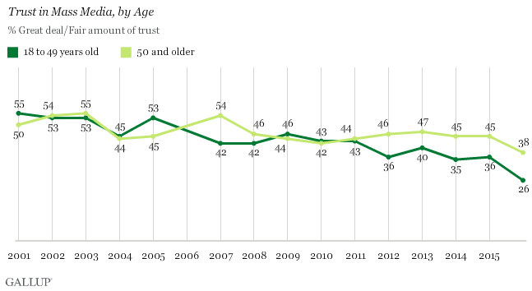
Today’s landscape
High polarization
Low trust
Media consolidation
Self reinforcing selection

Slide 10
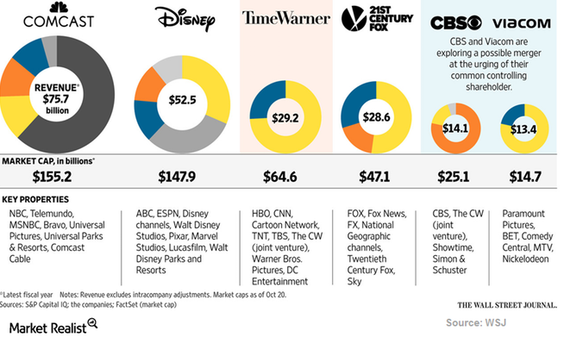
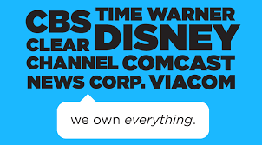

Today’s landscape
High polarization
Low trust
Media consolidation
Self reinforcing selection

Slide 11
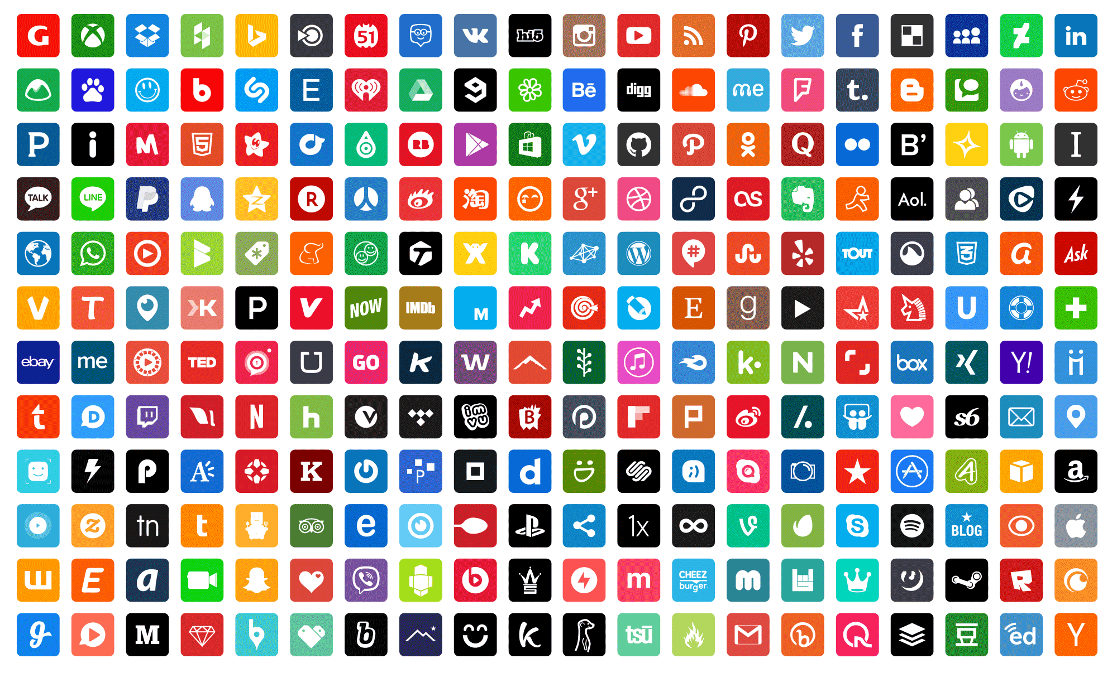
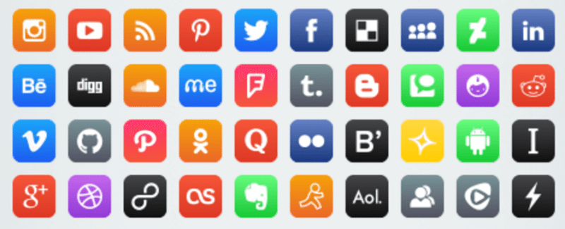

Today’s landscape
High polarization
Low trust
Media consolidation
Self reinforcing selection
Notes:
And of course the number of ways we can reinforce our previously held beliefs has multiplied

Slide 12
Recap
We’re politically polarized
We don’t have much trust
We have centralized ownership of media
We’re getting high on our own supply
Notes:
But there is a bright spot – look at Alabama. Seriously, when was the last time you heard someone say that?

Slide 13
Group Exercise
Look at the following words
For each word say its color out loud
Do NOT read the word – just say its color
Say the color as quickly as you can

Slide 15
Notes:
Guerilla suit
Driving, drinking coffee, listening to the radio – now try to compute 76 x 15

Slide 16
Cognitive Heuristics
Kahneman: System 1 shortcuts
Energy saving behavior
Unconscious / subconscious
Low/high information sensitive
Marketers’ friend
Notes:
What you just experienced is what Daniel Kahnemen calls system 1 and system 2 thinking. He posits that we

Slide 17
Cognitive Heuristics
Halo Effect & Sequencing
Alan:
Intelligent – industrious –impulsive – critical – stubborn – envious
Ben:
Envious– stubborn – critical – impulsive – industrious – intelligent
Nguyan
Notes:
If we like something about someone, we tend to adopt a very favorable impression and ignore other facts.

Slide 18
Cognitive Heuristics
Halo Effect & Sequencing
WYSIATI
Availability
Notes:
If we like something about someone, we tend to adopt a very favorable impression and ignore other facts.

Slide 19
Cognitive Heuristics
Current landscape reinforces & increases dependence on heuristics
Notes:
Halo Effect – in a highly polarized society, people will make judgements much more quickly about issues, candidates and they will be much less likely to accept information about those people or institutions that runs contrary to their initial feelings.
WYSIATI - in a highly centralized media environment, people may not have access to more than one source of media and will make decisoin on that basis
Availability – When the algorithems that dictate what information you receive rienforce your views, then you will be increasing the likelhood that you can recall those beliefs in the first place

Slide 20
Cognitive Heuristics
Understanding heuristics helps:
Sequence your messages
Frame your story
Understand your audience

Slide 21
Audience & Motivation
Who are our audiences?
What motivates them?

Slide 22
Audience Model:
Architects - create new thinking and propose new solutions to help create change
Influencers – Don’t have direct power, but can shape the debate and influence change
Decision Makers – Have the authority to create change
Implementers - individuals, organizations and institutions who are ultimately tasked with carrying out the change

Slide 23
Motivation
Financial
Outer
Circle
Peer
Pressure
Motivation Model
Inner
Circle
Competition

Slide 24
Communicating for Impact
Tad Segal:
tsegal@outreachstrategies.com
@TadSegalOS
Tad Segal

